Slide 1

mightyMouse
by
Sai Gangadhar Veeramreddy
Sai Krishna Jakkampudi
Sravani Ravulaparthi

Slide 2
mightyMouse Project Proposal
Despite Apple's growth and success in becoming one of the largest companies globally, surpassing even Microsoft, Microsoft still holds a significant portion of the market for office productivity software.
In essence, the mightyMouse would be a compact and wireless Bluetooth mouse, meant to be used in conjunction with wireless Bluetooth keyboards, providing iDevice users with a way to interact with iWork applications.
Proposed features of mightyMouse:
Provide an interface for wirelessly streaming movies to iDevices from Apple TV storage appliances.
Designed to serve as a travel mouse for the ultra-light Apple Brick laptops
It will also have a slot incorporated for a flash drive to provide storage for transferring data to and from the iDevices
It will also be compatible with the Airdrop wireless transfer process
Aside from boosting the popularity and sales of iWork applications, Apple could also pose a challenge to Microsoft's Office product line by providing a viable alternative.

Slide 3

Project Milestones
Concept Development
System Design and Development
Design and Prototype Development
Operations and Maintenance
Production and Testing
Deployment and Launch
Milestone 7: IOC System Acceptance T & E
Milestone 1: System Design Review (SDR)
Milestone 3: Critical Design Review (CDR)
Milestone 5: System Validation Review (SVR)
Milestone 2: Preliminary Design Review (PDR)
Milestone 4: Technical Review and Refinement (TRR)
Milestone 6: Developmental Testing and Evaluation (DT&E)

Slide 4
Project Plan Timeline
2023
2024
2025
Mar | May | Sep | Nov | Mar | Sep | Nov | Feb
Concept Development
System Design and Development
Design and Prototype Development
Production and Testing
Deployment and Launch
Operations and Maintenance

Slide 5
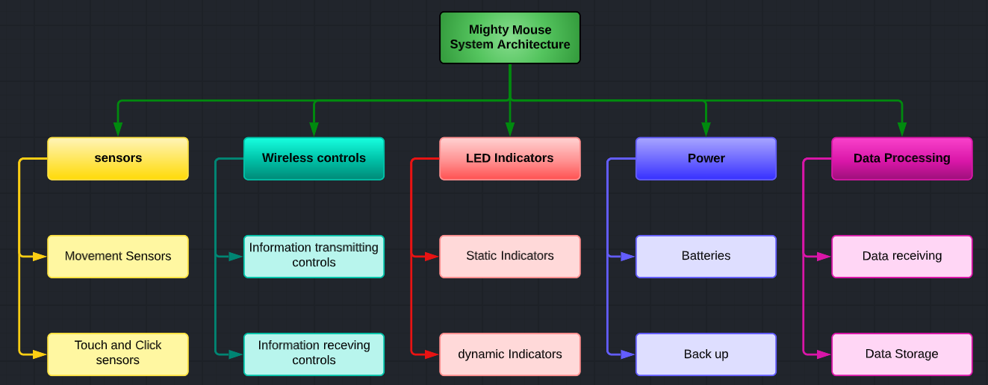
System Architecture

Slide 6
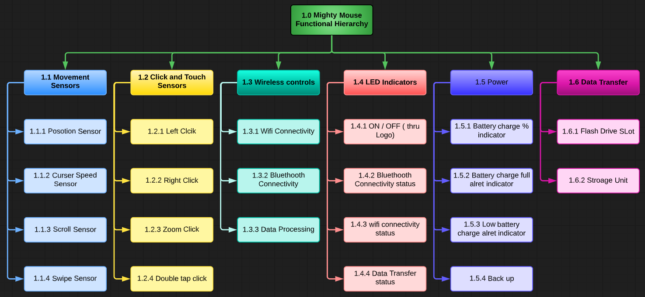
Functional Hierarchy

Slide 7
Requirement Statements
Requirement Statement 1:
Level of Architecture: Component
Requirements Baseline: Product
Description: The scroll wheel component of the mightyMouse shall have a maximum resistance force of 30g, to ensure smooth scrolling for the end user.
Requirement Statement 2:
Level of Architecture: Assembly
Requirements Baseline: Functional
Description: The microcontroller component shall have a maximum response time of 1 millisecond to ensure quick and responsive user input.

Slide 8
CDRL’s

Slide 9
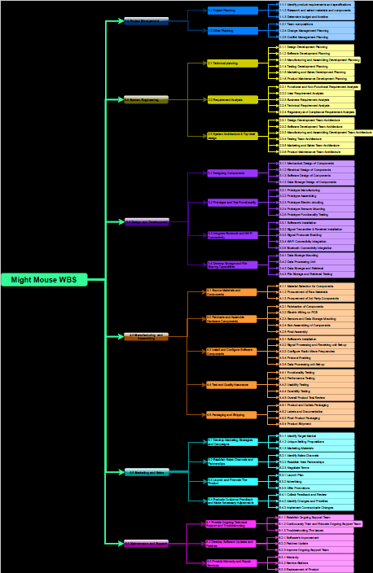
WBS

Slide 10


